Slide 1
GIS and Disaster Management

Slide 2
Table of Contents
Introduction to Disaster Management
What is GIS ?
GIS in Disaster Management
Applications of GIS
GIS and Disaster Management Cycle
GIS and Emergency Shelters
GIS and Distribution of Relief
GIS and Data Gathering
Advantages of GIS
Challenges of using GIS in Disaster Management

Slide 3
DISASTER MANAGEMENT
Disaster is an event causing great damage , injury or loss of life
Disaster management can be defined as the discipline and profession of applying science, technology, planning and management to deal with extreme events.
The emphasis of disaster management prevention and loss reduction

Slide 4

Geographic Information Systems (GIS)
Gis is a computer system used for capturing , storing , querying and analyzing and displaying geospatial data
GIS FUNCTIONS
Spatial data management
Display
Query
Modify
Output

Slide 5
GIS in Disaster management
Accurate data availability
Location of site accurately within least permissible time
Accessibility information between source and destination
Real time visualization of area of interest
Reduce the time element involved in activities

Slide 6
Application of GIS
Used for Warning System
Hazard Mapping
Locate Critical Facilities
Disaster Management
Vulnerability Assessment

Slide 7
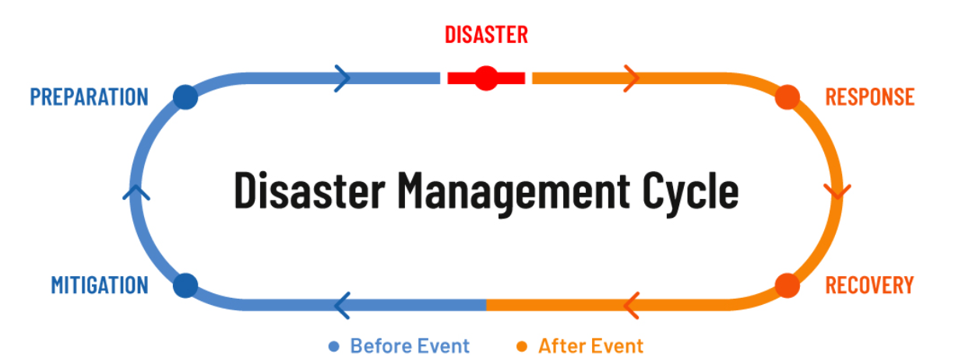
GIS and Disaster Management Cycle
Disaster Management is having two parts:-
Pre-Disaster Stage
Mitigation: Minimize the effects of the disasters before their occurence
Preparedness:- Involves the development of an emergency operations plan
Post-Disaster Stage
Response:- Emergency helps the people
Recovery:- Back to Normal Life after the occurrence of the Disaster Event

Slide 8

GIS and Emergency Shelters
Emergency shelter means any facility, the primary purpose of which is to provide a temporary shelter for the homeless.
Real-time geographic data can improve allocation of emergency shelters.
Using GIS, we can emergency shelters prepared.

Slide 9
GIS and Distribution of Relief
GIS technology plays a key role in identifying disaster-affected locations and providing shelter for affected people.
The survivors need immediate support in terms of physical assistance and relief material. For efficient relief distribution, advance planning and preparedness is a must.
In the event of a disaster, people need emergency assistance after the disaster. The central / state government or relief team address/respond to all those in need of help during the time of the fight against a disaster with of help of GIS Technology.
With GIS tools, authorities can get access to emergency unit locations, shelter population capacities, supply inventories, power, identify locations of public safety resources, and status of the overall situation

Slide 10
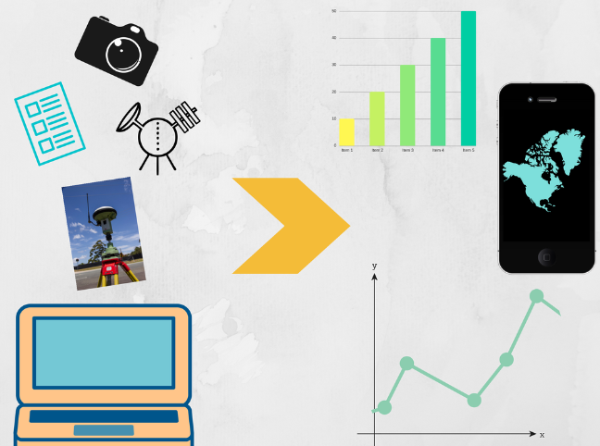
GIS and Data Gathering
GIS has mainly two types of data sources :
Primary data sources - These are data sources which are collected in digital format specially for use in a GIS project. Examples : Raster form - Digital Aerial photographs , Vector form - GPS measurements.
Secondary data sources - These are digital and analog datasets that were originally captured for another purpose and need to be converted into a suitable digital format for use in a GIS project. Examples : Raster form - Scanned Maps , Vector form - Topographic surveys
Data Collection workflow - Planning , Preparation , Digitizing and transfer , Editing and improvement and Evaluation.

Slide 11
Advantages of GIS
GIS helps us to answer questions and solve problems by looking at the data in a way that is quickly understood.
Allows us to view ,understand and visualize the data.
Helps in getting better predictions and analysis.
GIS gives the accurate data.

Slide 12
Challenges of using GIS in Disaster Management
PROHIBITIVE COST - The software cost along with additional hardware cost, employee onboarding costs and additional data collection costs can be expensive for many users.
INCONSISTENCIES IN DATA - The decisions are only as good as the data used to make them. GIS relies on spatial databases which have the same challenges as of other databases.
AREA LIMITATIONS - GIS software is typically limited to smaller regions.
BIG DATA MANAGEMENT - A GIS system stores a large amount of data at any given time. This may create problems for analysis due to complexity of data and risk of generalization.

Slide 13
THANK YOU
By:-
Mohit Garg: 19ucc027
Rajat Soni: 19ucc014
Raja Singh: 19ucc019
Mohit Akhouri: 19ucc023
Mohit Dudhe: 19ucc028

